Slide 1
Timing Manipulation and Signal Analysis of Monosyllabic Words as Part of a Study on Speech Comprehensibility
Anthony Gillan
3rd Year EEE

Slide 2
OVERVIEW
GOAL: Create syllable-timing-manipulated sentences for a psychophysical study on speech comprehensibility.
In future these manipulation and analysis techniques will hopefully be used to monitor phase entrainment of low-frequency cortical oscillations to syllable envelopes.

Slide 3
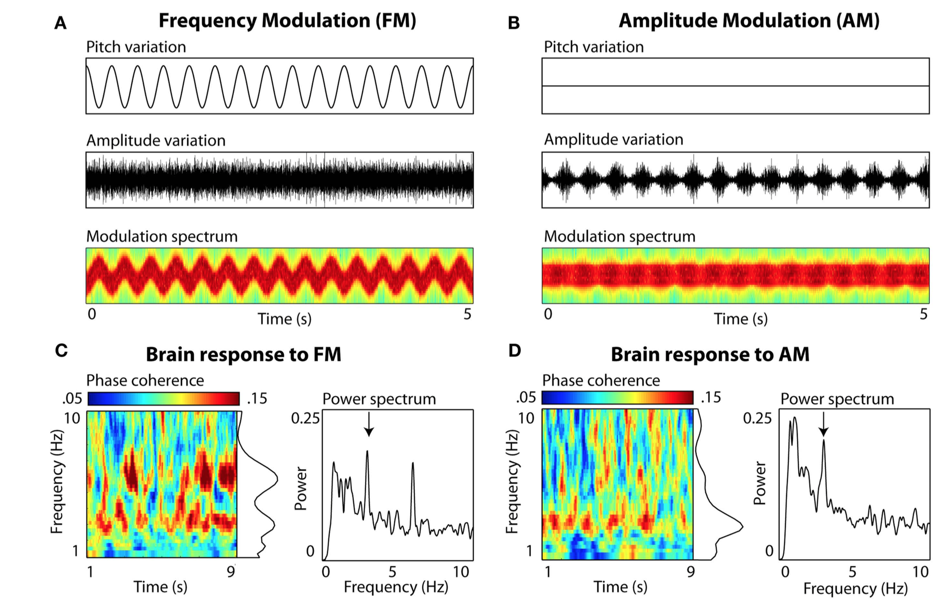
FM and AM coherence
Obleser, J., Herrmann, B., & Henry, M. (2012). Neural oscillations in speech: Don't be enslaved by the envelope. Frontiers in Human Neuroscience, 6: 250. doi:10.3389/fnhum.2012.00250.

Slide 4
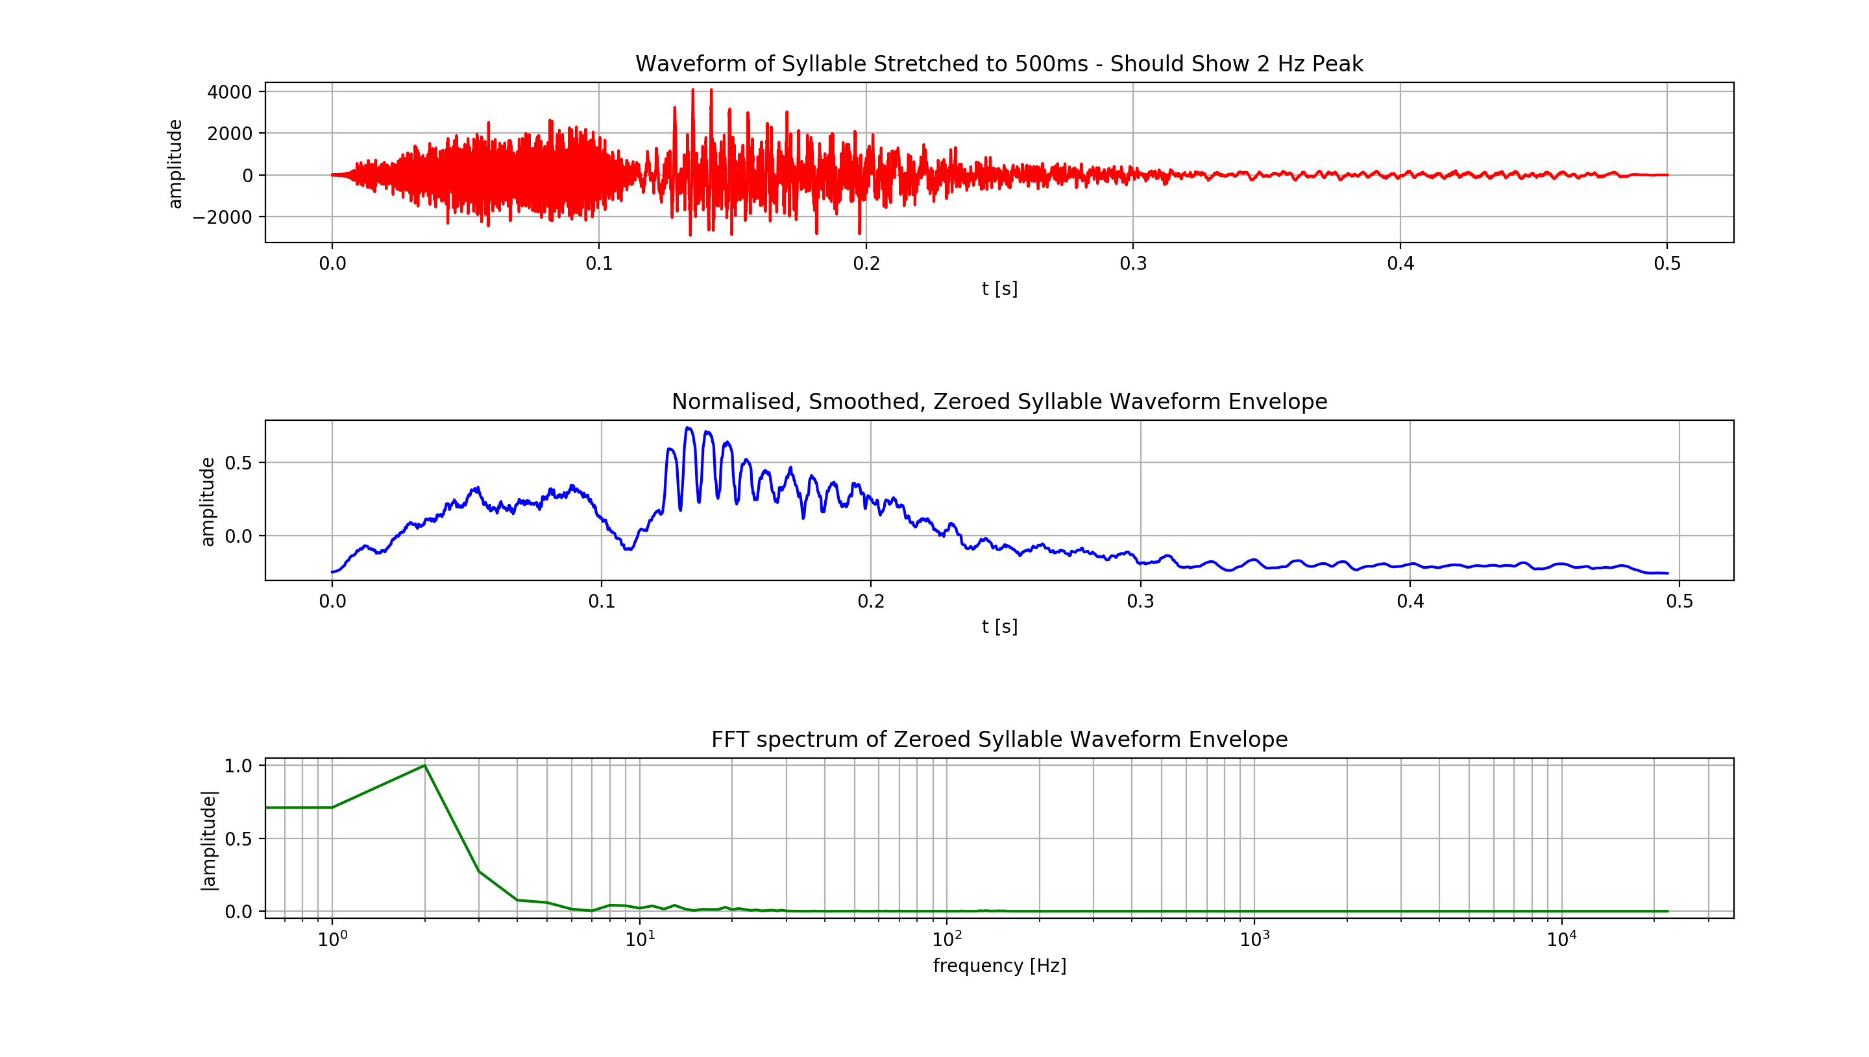
Synthesise Monosyllabic words and strip silence
Waveform of the word ‘Sam’

Slide 5
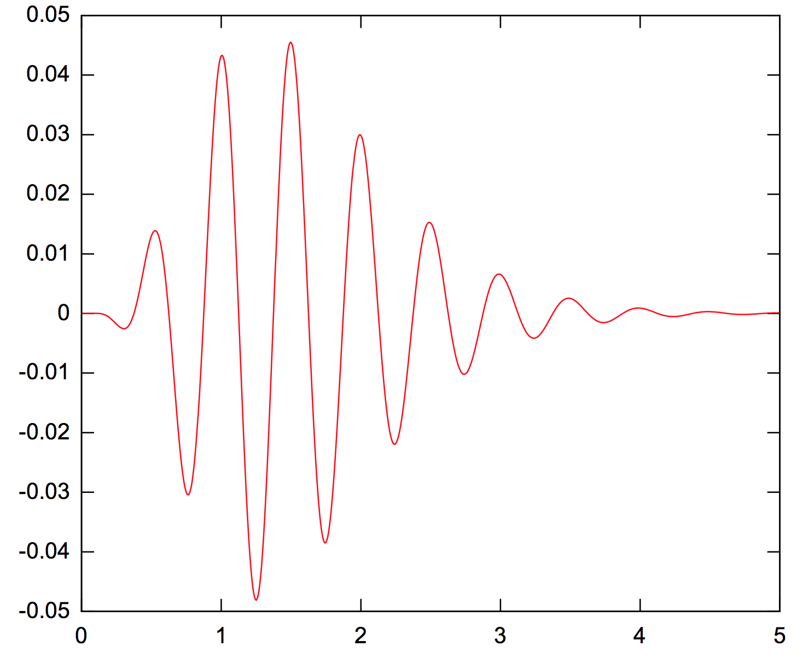
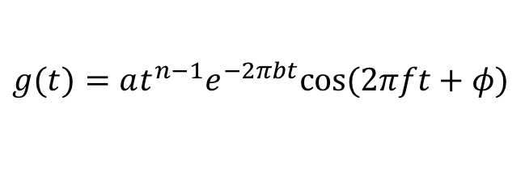
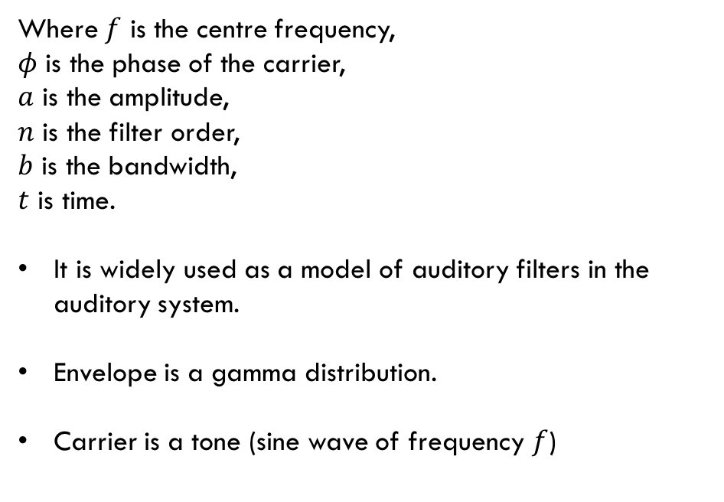
Generate Gammatone Filters
Impulse Response
Impulse response is given by
$$g(t)=at^{n−1}e^{−2πbt}cos⁡(2πft+φ)$$
Where $f$ is the centre frequency,
$φ$ is the phase of the carrier,
$a$ is the amplitude,
$n$ is the filter order,
$b$ is the bandwidth,
$t$ is time.
It is widely used as a model of auditory filters in the auditory system.
Envelope is a gamma distribution.
Carrier is a tone (sine wave of frequency $f$)

Slide 6
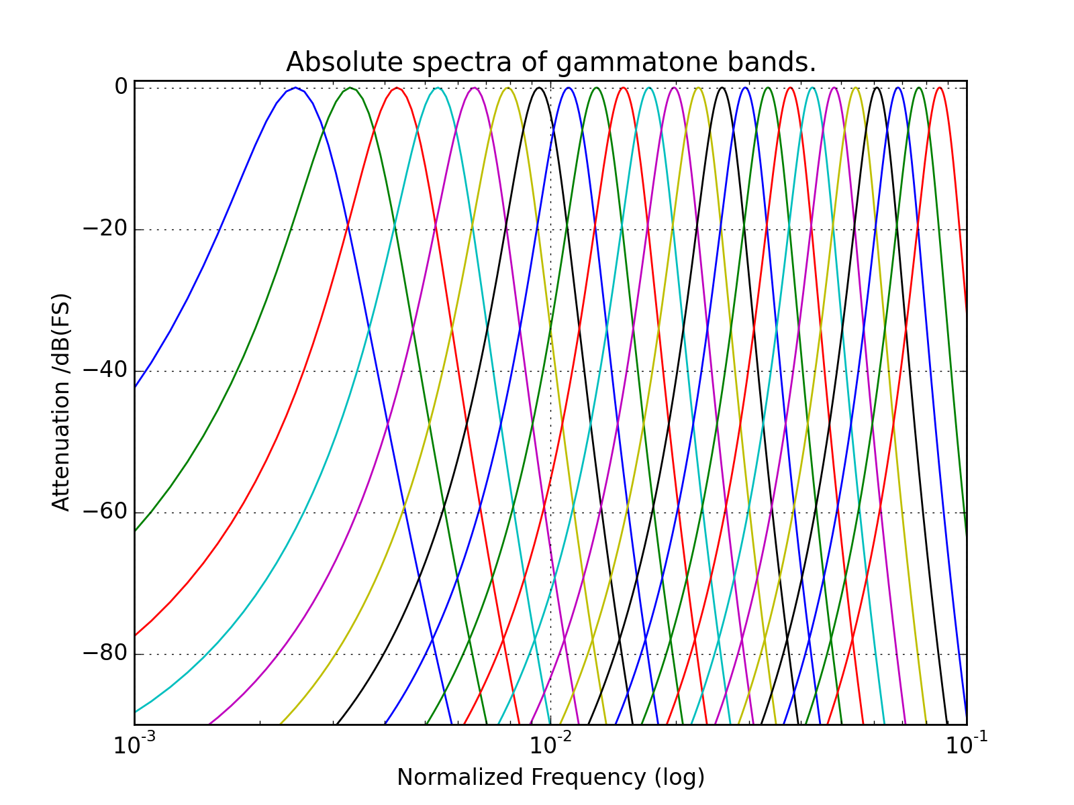
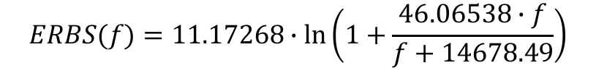


Generate gammatone filters
A bank of filters is created for a given number of bands.
Bands are sized and spaced using the equal rectangular bandwidth scale, approximating the filters in human hearing, mimicking the action of hair cells.
Bandwidths are calculated using:
$$ERBS(f)=11.17268∙ln⁡\left(1+\frac{46.06538∙f}{f+14678.49}\right)$$
$$f_{max}=8 kHz$$
$$f_{min}=80 Hz$$

Slide 7
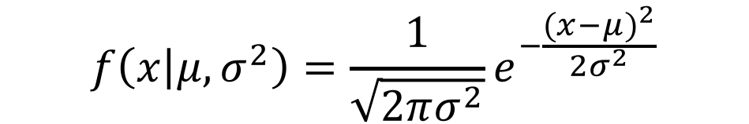
Generate white noise using standard normal distribution
$$f\left(x | μ,σ^{2}\right)=\frac{1}{\sqrt{2πσ^{2}}}e^{−\frac{{(x−μ)}^{2}}{2σ^{2}}}$$
$$μ=0$$
$$σ^{2}=1$$
Noise generated to contain as many samples as the stretched word does

Slide 8
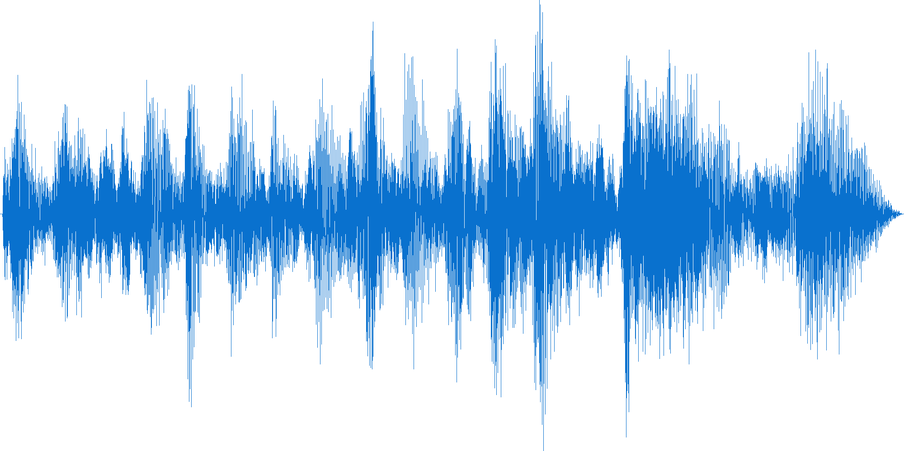
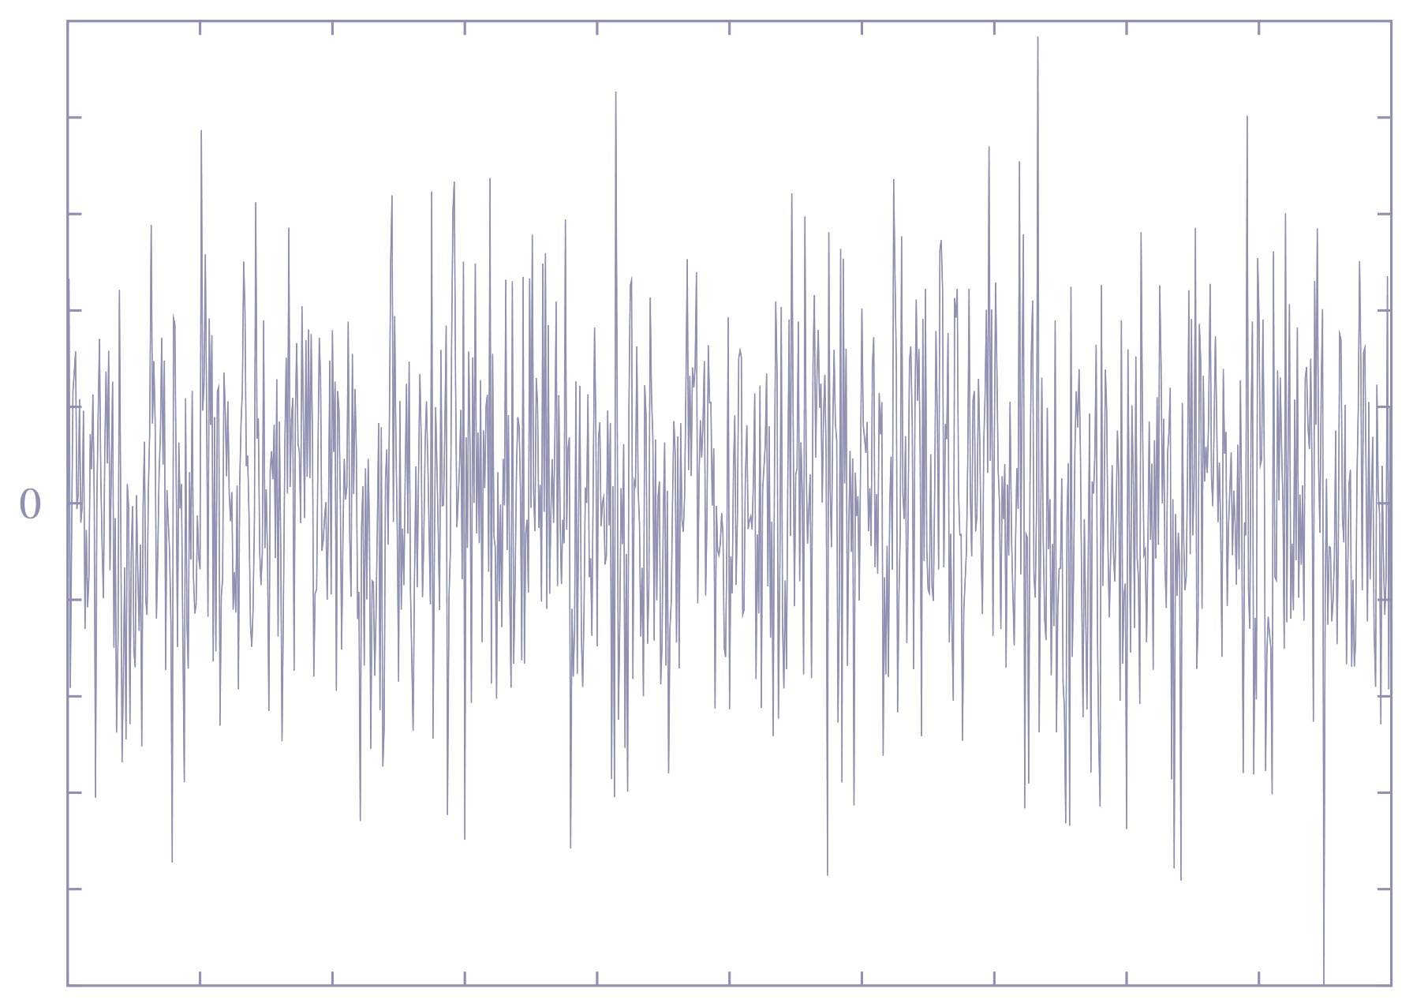
Decompose noise and word through gammatone bank
WORD
NOISE

Slide 9
Obtain Envelope of each filter’s output signal for word input into filterbank
Envelopes are given by taking the Hilbert transform of the signal to form the analytic signal
1. Take Hilbert transform of signal
$$\hat{f}\left(t\right)=H\left[f(t)\right]$$
2. Form analytic signal
$f_{a}\left(t\right)=f\left(t\right)+i$ $\hat{f}\left(t\right)=e\left[f\left(t\right)\right]{∙e}^{iφ(t)}$
3. Envelope is given by magnitude of analytic signal
$$e\left[f\left(t\right)\right]=|f_{a}\left(t\right)|$$

Slide 10
Time stretch envelopes

Slide 11

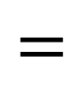
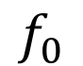
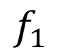
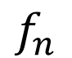

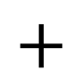

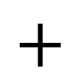
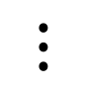
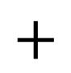
Multiply envelopes with filtered noise in corresponding bands And sum
$$f_{0}$$
$$×$$
$$+$$
$$f_{1}$$
$$×$$
$$+$$
$$⋮$$
$$+$$
$$f_{n}$$
$$×$$
$$=$$

Slide 12

Original sample

Slide 13
Result with no stretching

Slide 14
Result 2x stretched

Slide 15
Result 2x stretched using new strategy

Slide 16
New strategy – phase vocoding

Slide 17
Synthesise Monosyllabic words and strip silence
Waveform of the word ‘Sam’

Slide 18
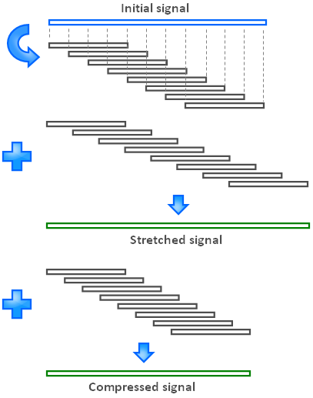
Stretch with phase vocoder
decreased overlap
increased overlap

Slide 19
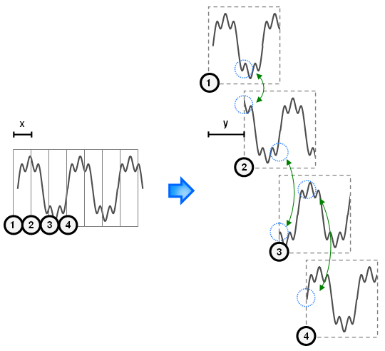
Phase discontinuities are created during the window shifting operation

Slide 20
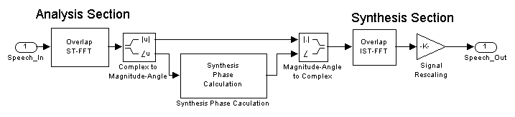
Stretch With Phase Vocoder
Using window overlap change and phase calculations on successive windows, the sinusoidal components
existing between STFT ’snapshots’ can be assigned appropriate (wrapped) phases for synthesis to avoid discontinuities.

Slide 21
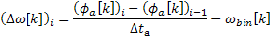
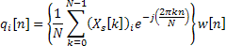
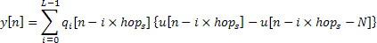
The gist of the phase vocoder
Calculate phase change between
frames in order to get true frequency
To ‘re-phase’ for synthesis
frequency deviation from frequency of bin
wrapped frequency deviation
Complex phases are wrapped
true frequency
phase to ‘re-phase’ next frame with
ISTFT
overlap-add

Slide 22
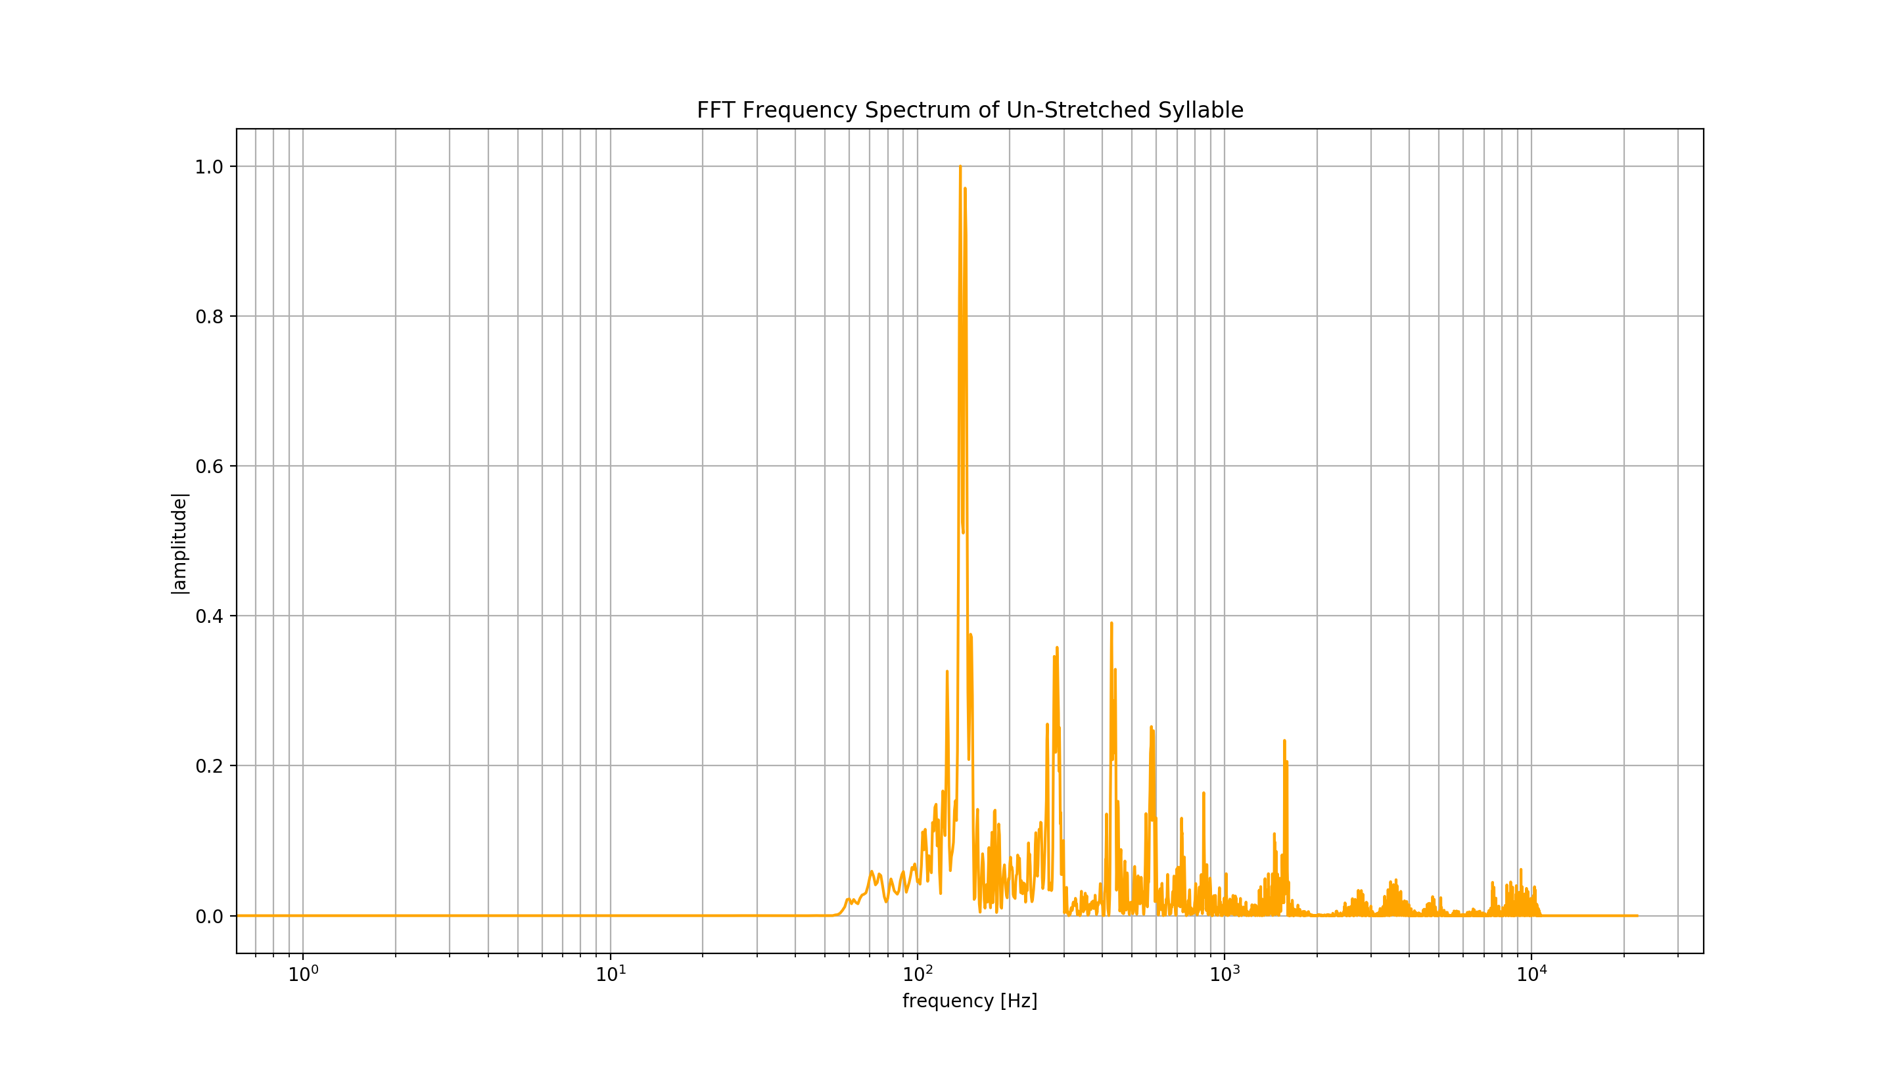
Fft frequency spectrum of original signal

Slide 23
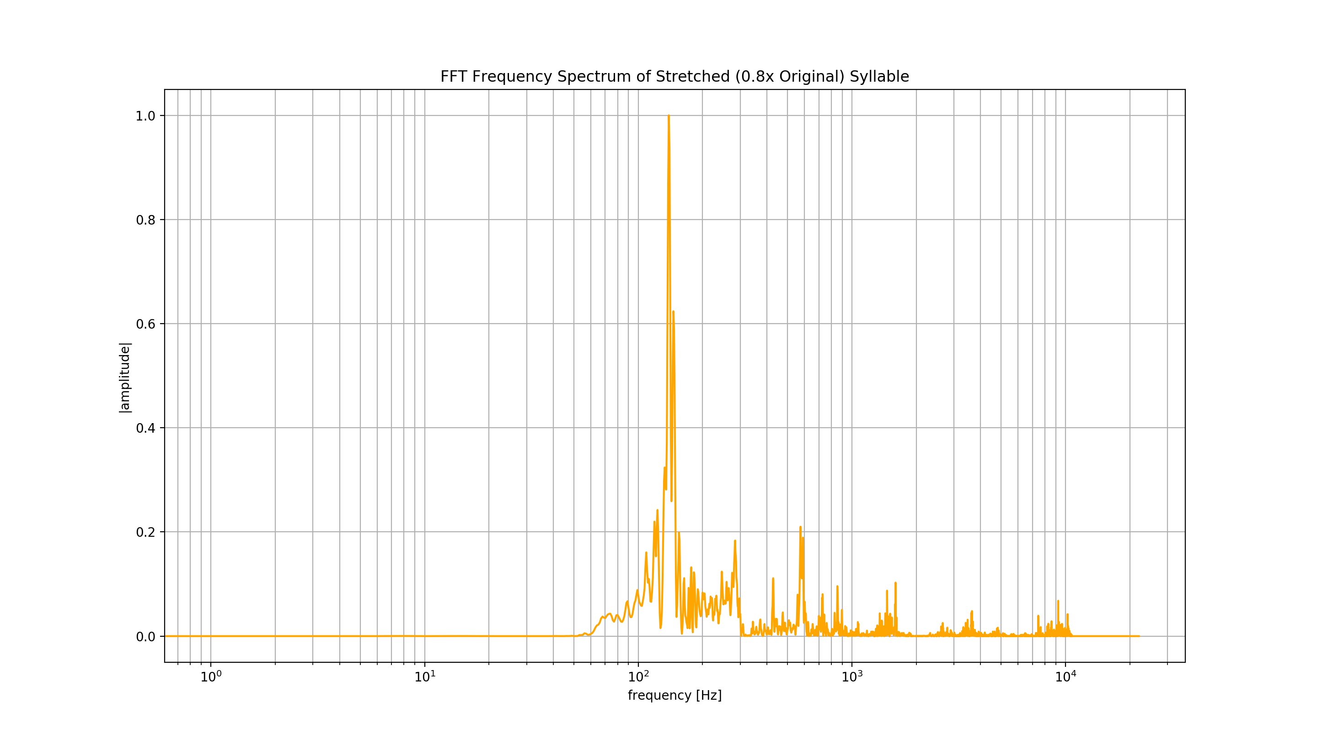
0.8x stretch

Slide 24
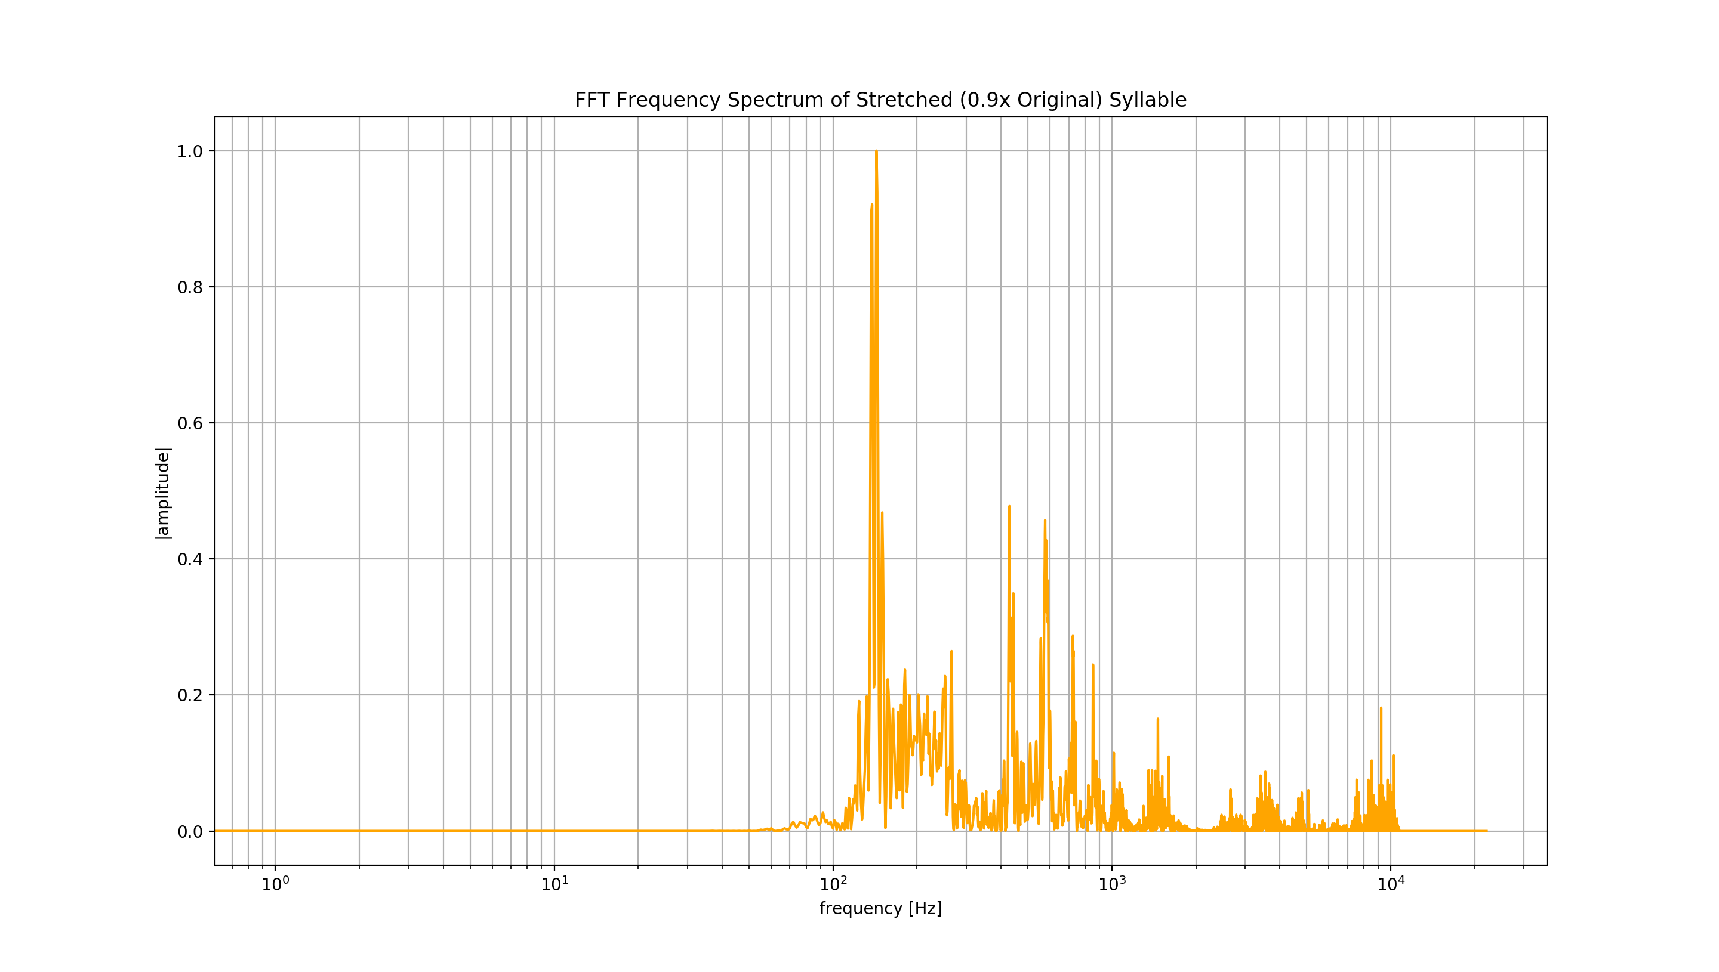
0.9x stretch

Slide 25
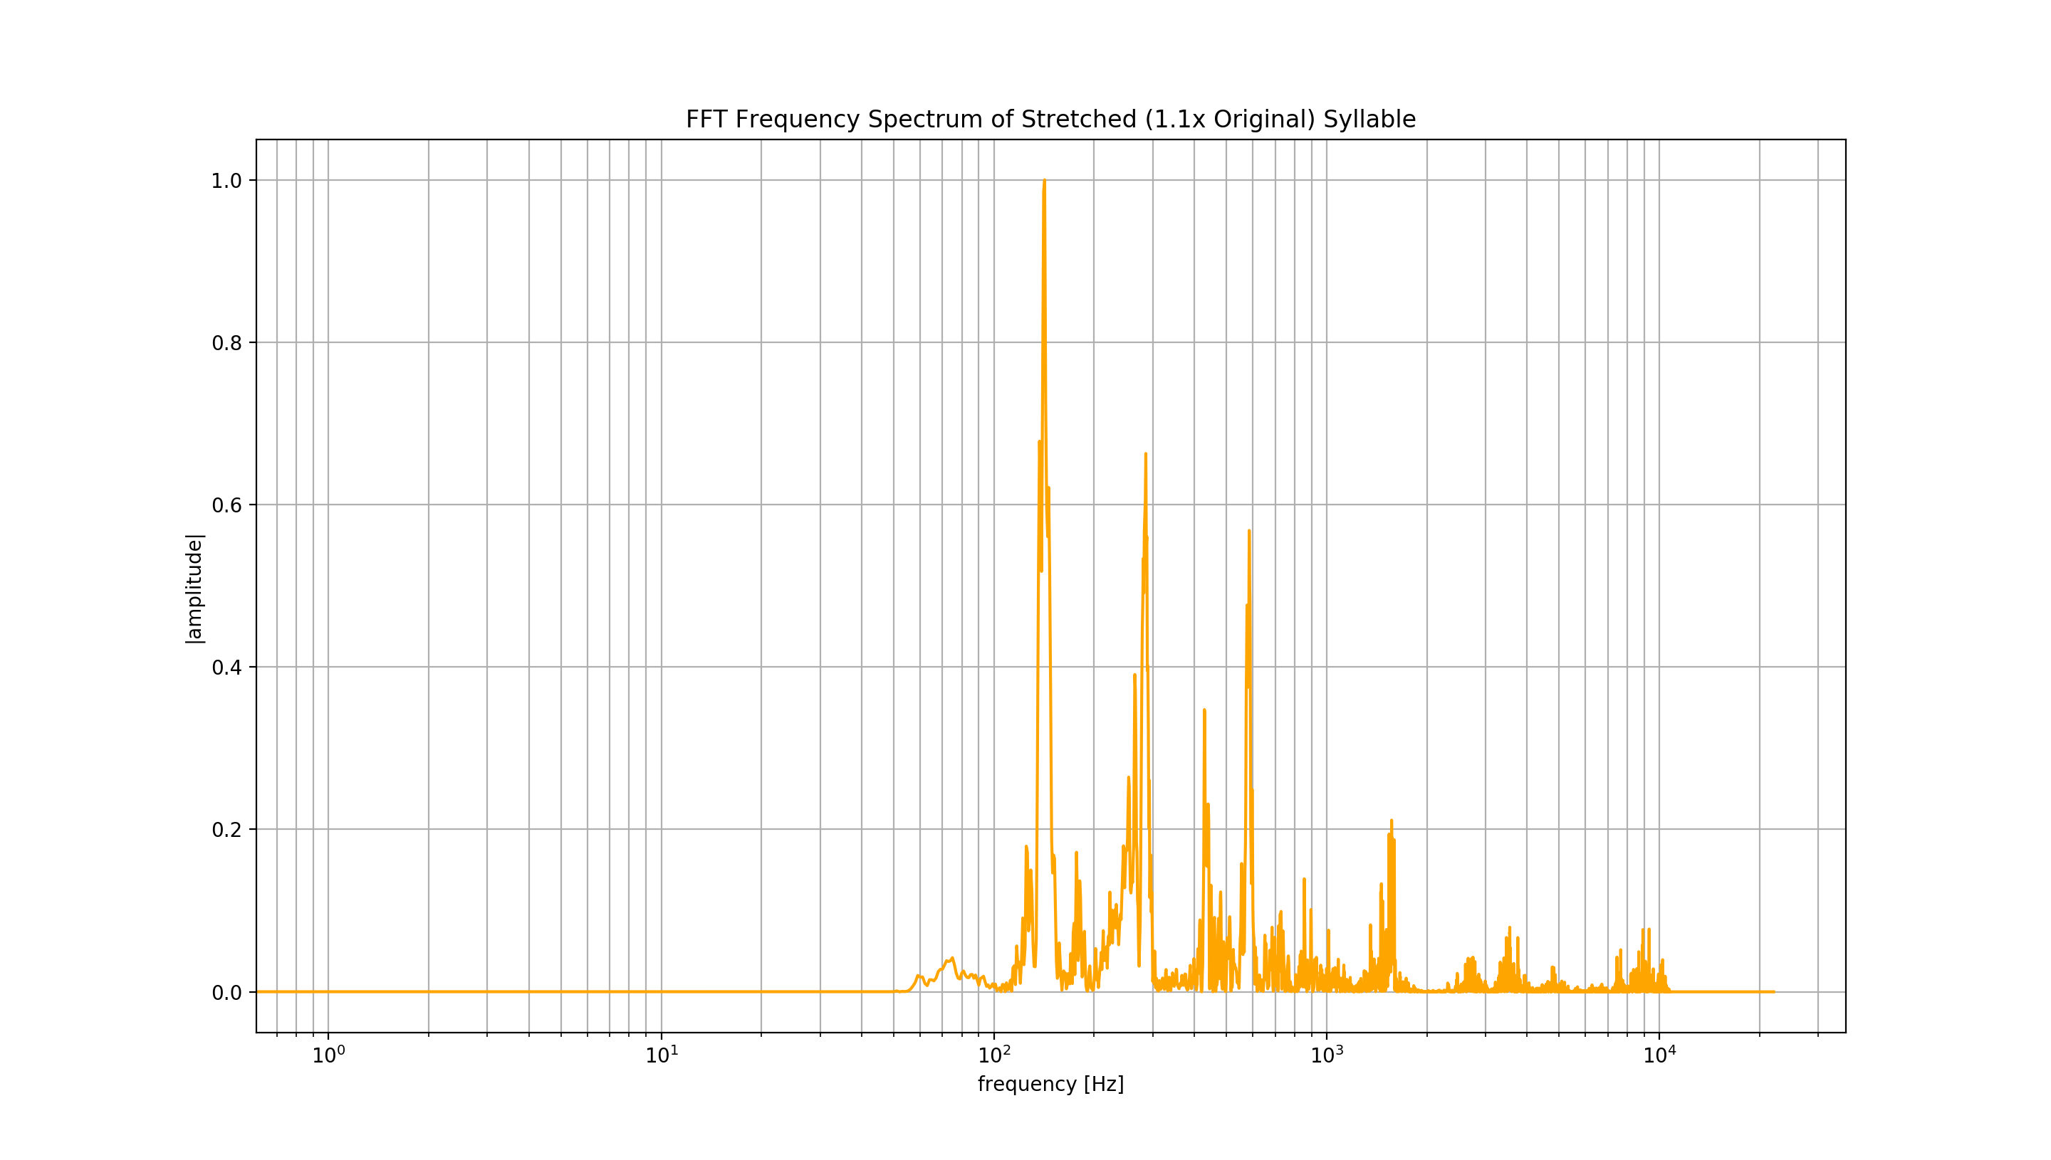
1.1x stretch

Slide 26
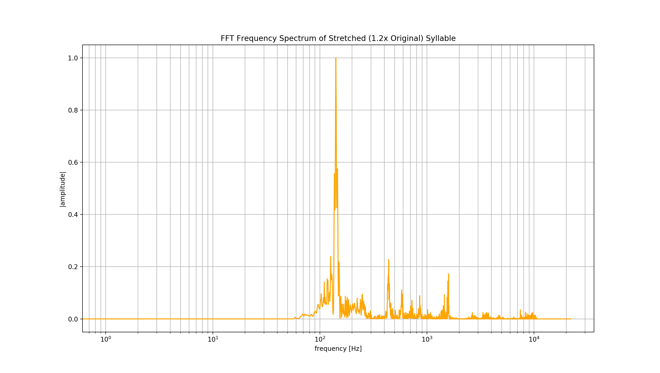
1.2x stretch

Slide 27
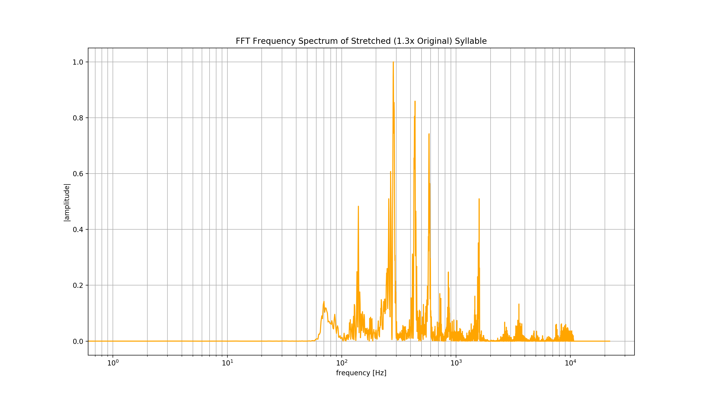
1.3x stretch

Slide 28
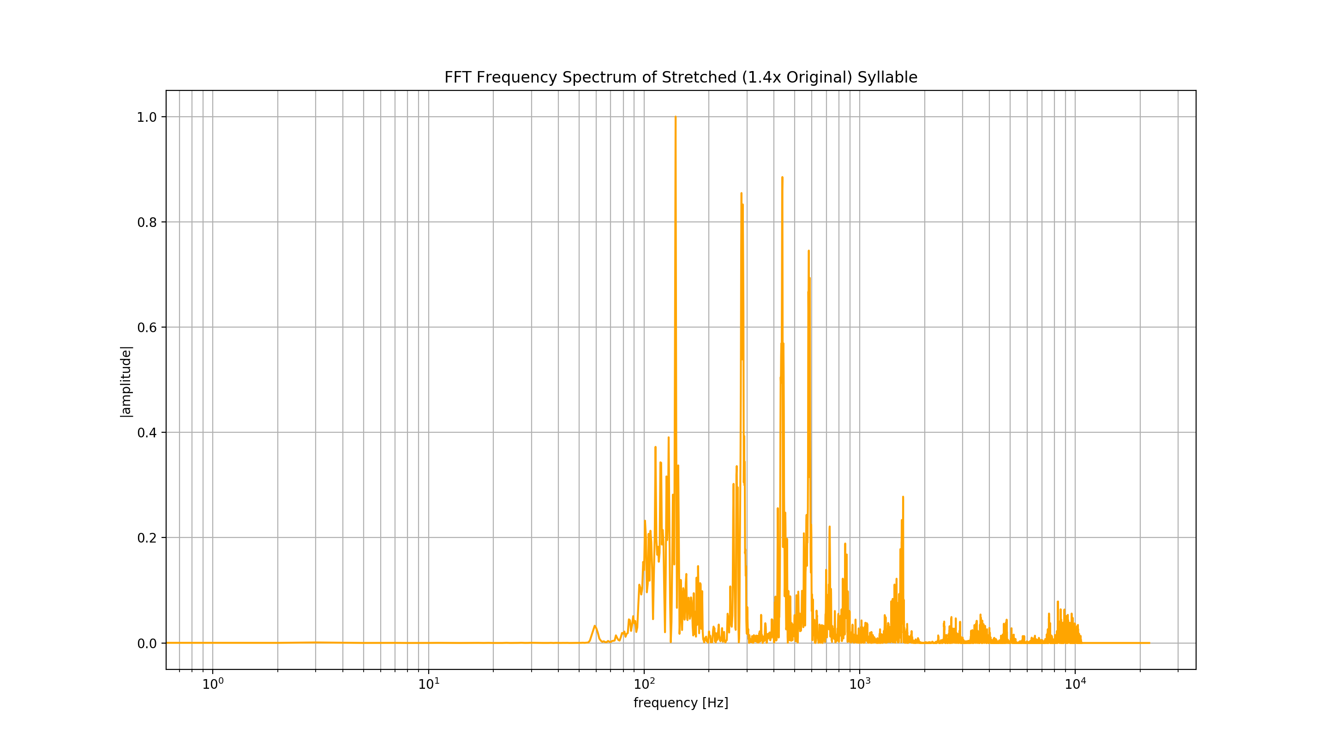
1.4x stretch

Slide 29
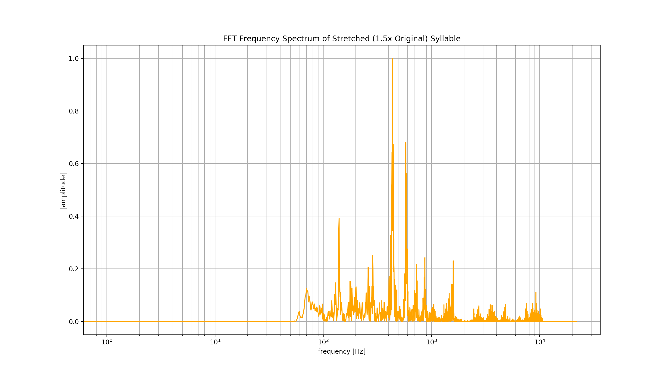
1.5x stretch

Slide 30
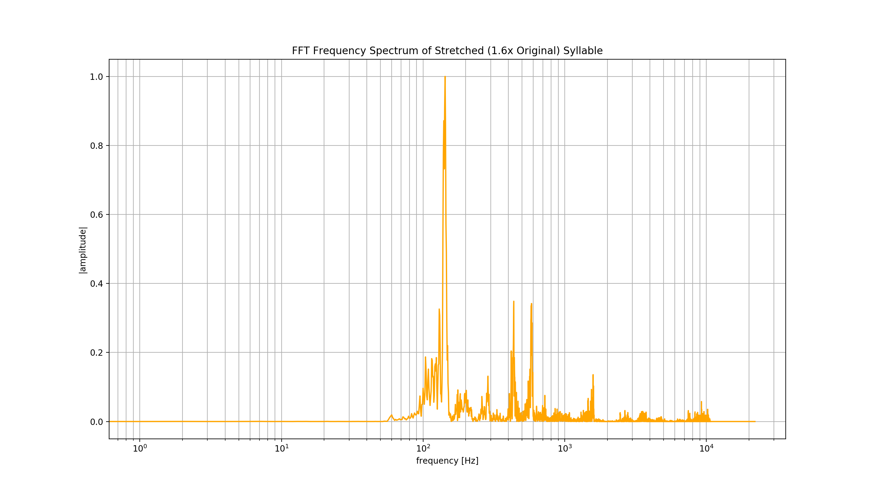
1.6x stretch

Slide 31
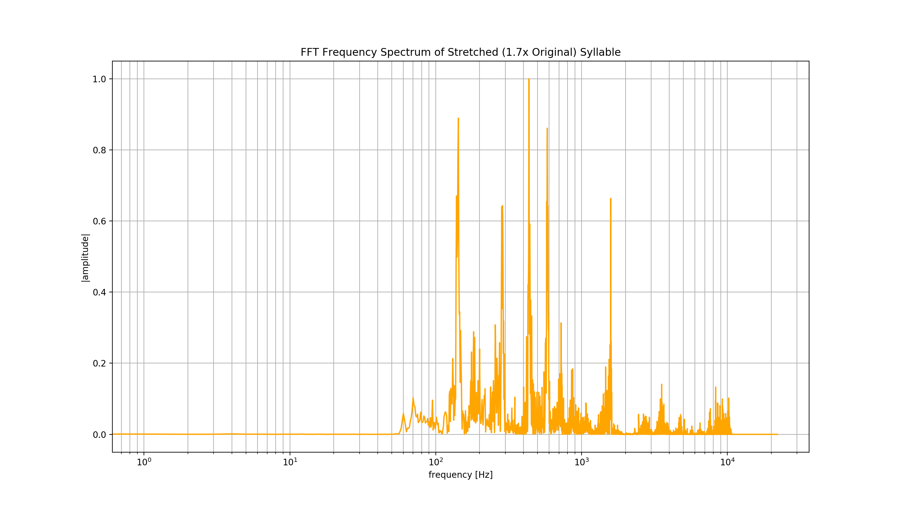
1.7x stretch

Slide 32
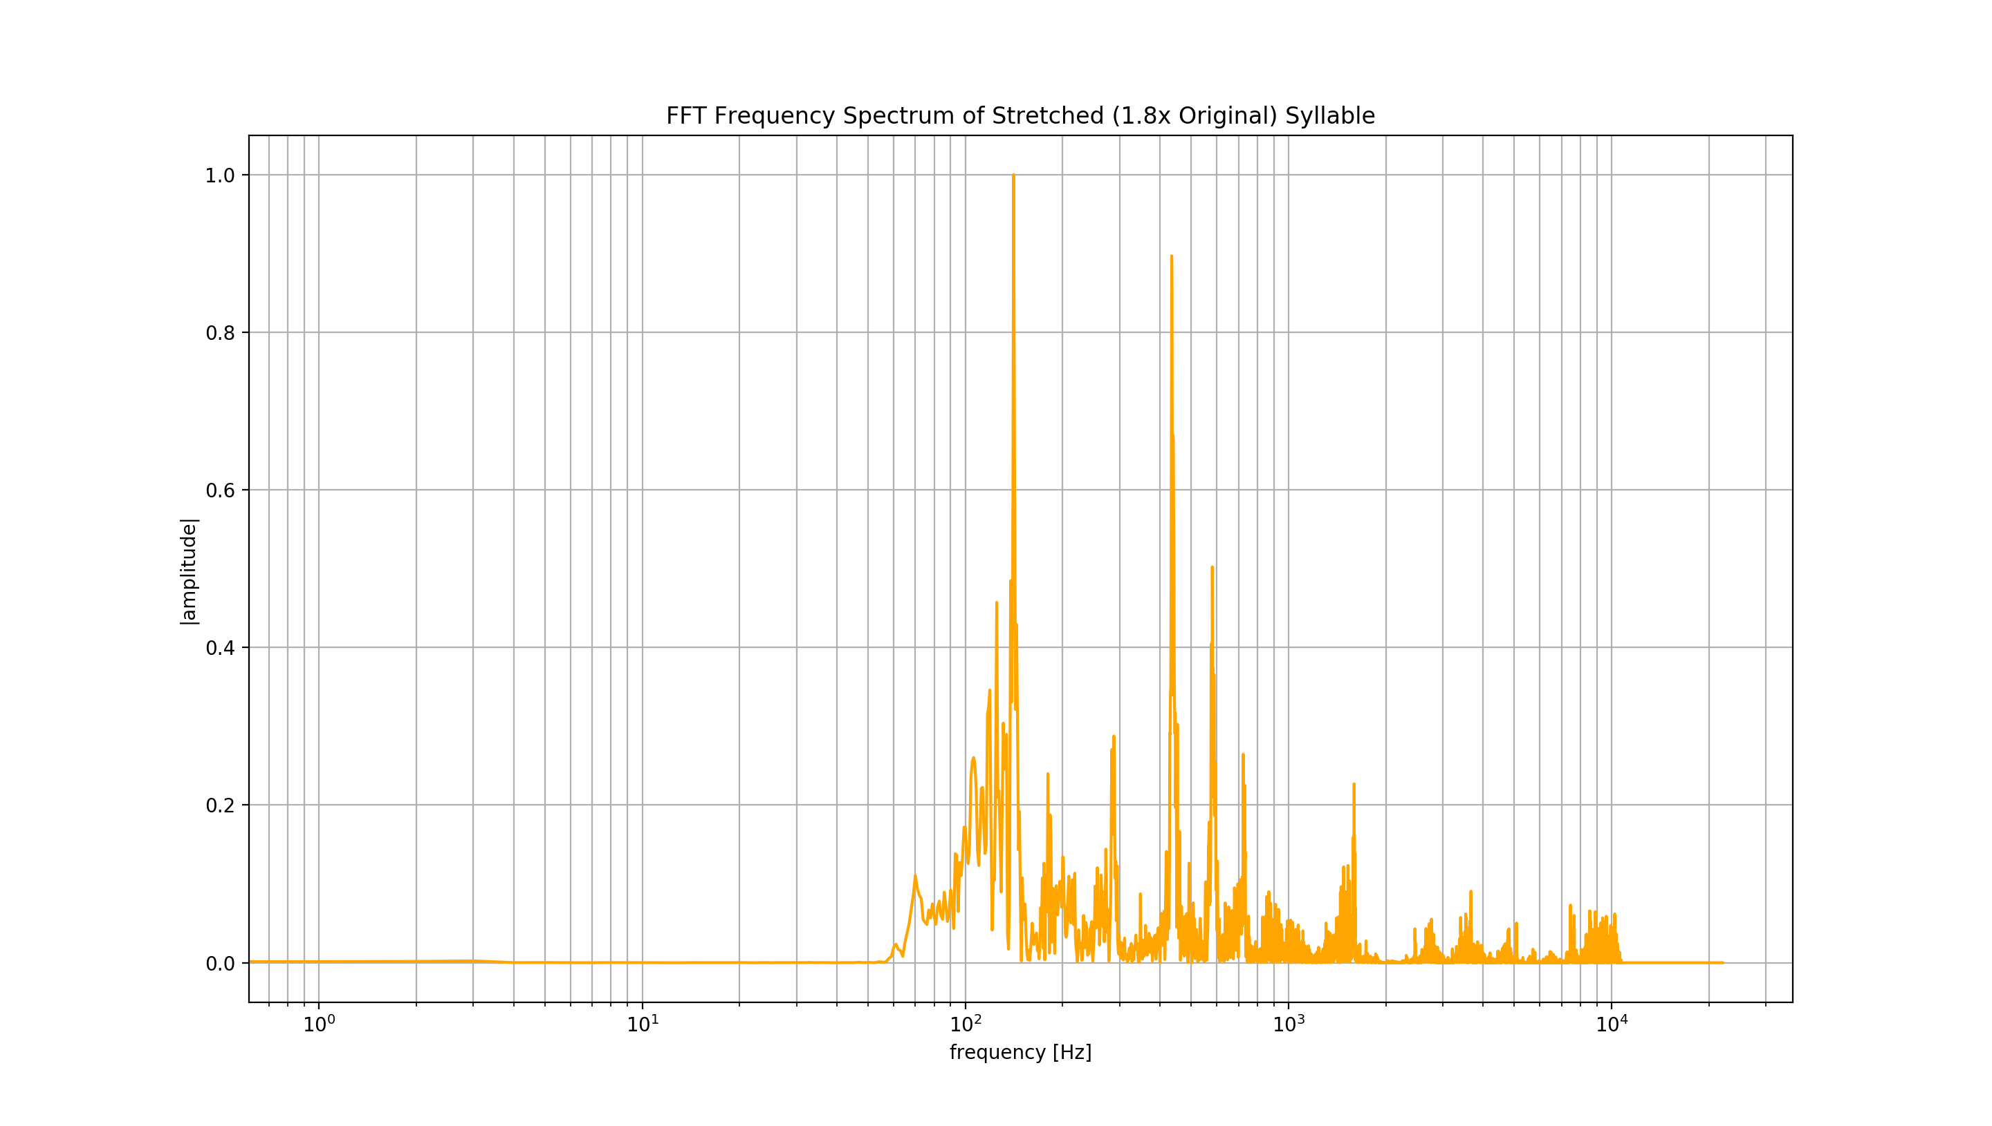
1.8x stretch

Slide 33
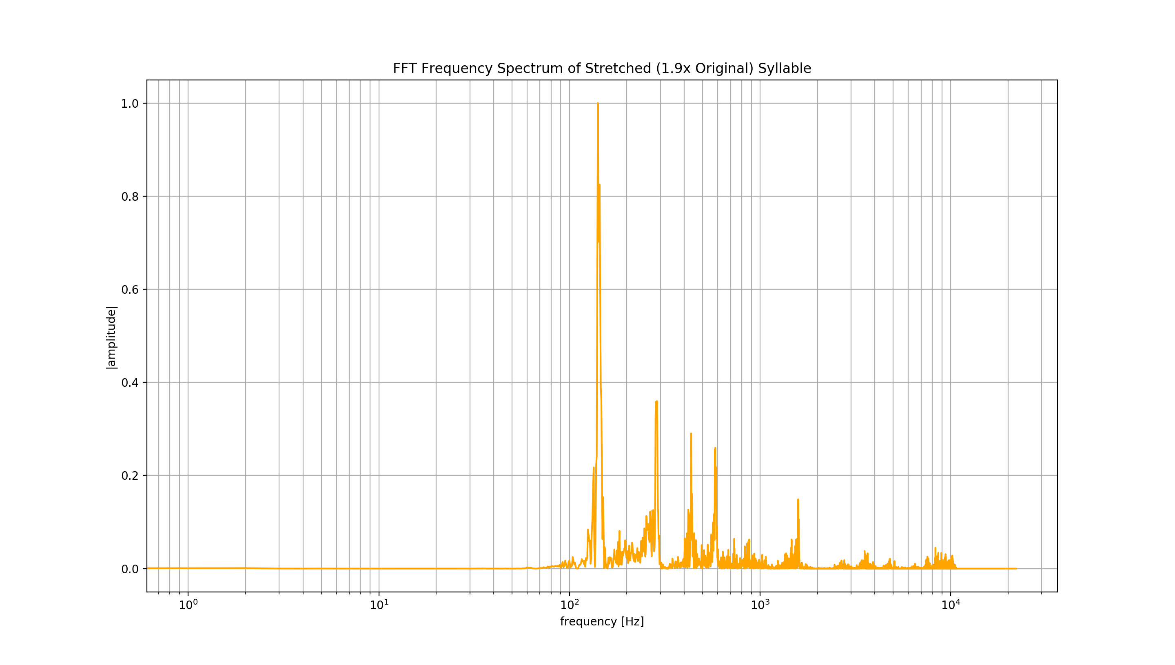
1.9x stretch

Slide 34
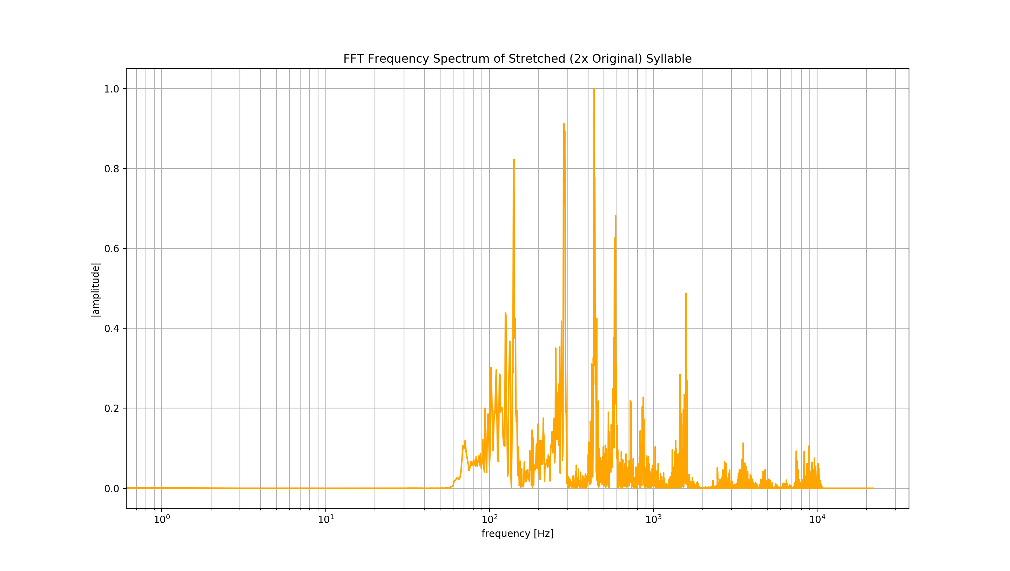
2.0x stretch

Slide 35
Extract envelope of stretched sound with hilbert transform, Smooth And Zero
stretched signal
signal Envelope
modulation spectrum

Slide 36
Waveform stretched
500ms length
stretched signal
signal Envelope
Shows 2 Hz peak
modulation spectrum

Slide 37
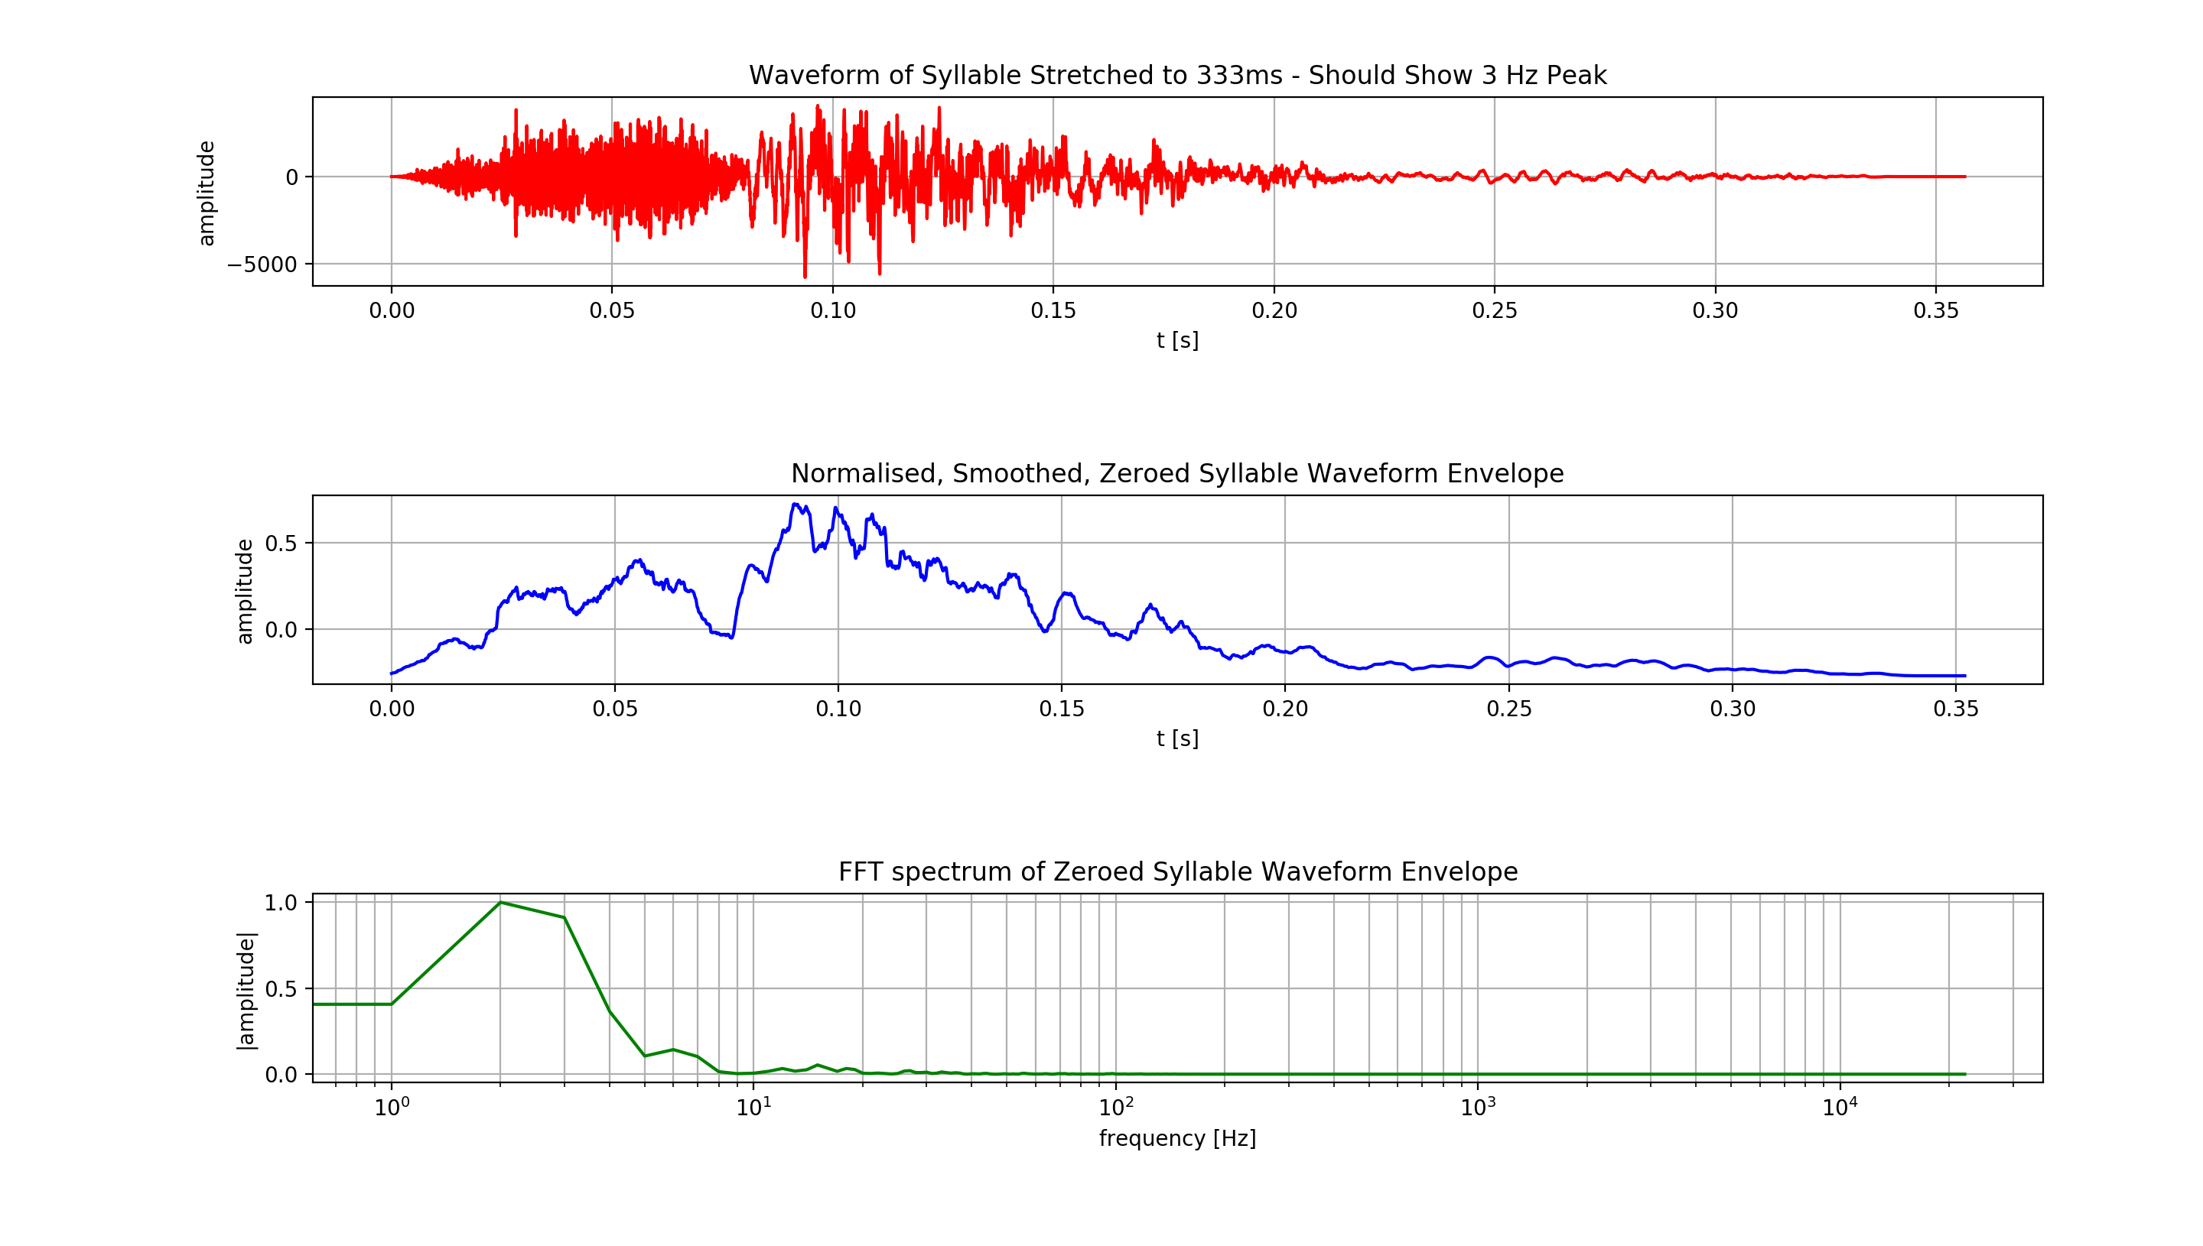
Waveform stretched
333ms length
stretched signal
signal Envelope
Shows 2/3 Hz peak
modulation spectrum

Slide 38
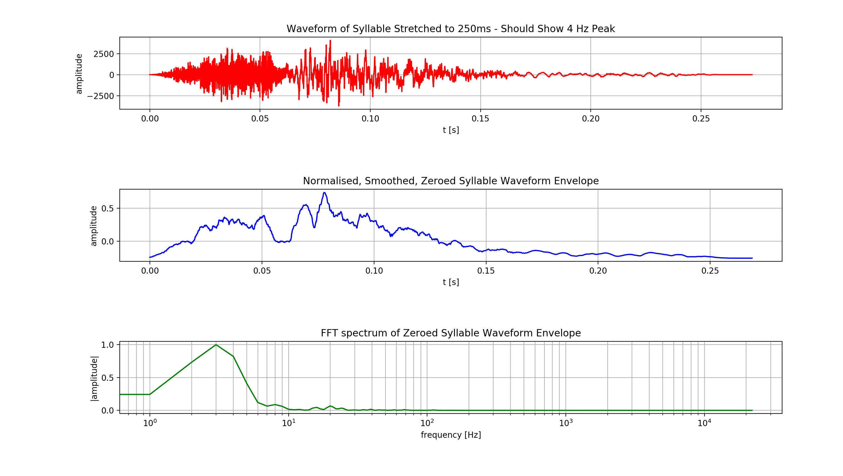
Waveform stretched
250ms length
stretched signal
signal Envelope
Shows 3/4 Hz peak
modulation spectrum

Slide 39

Waveform stretched
200ms length
stretched signal
signal Envelope
Shows 4/5 Hz peak
modulation spectrum

Slide 40
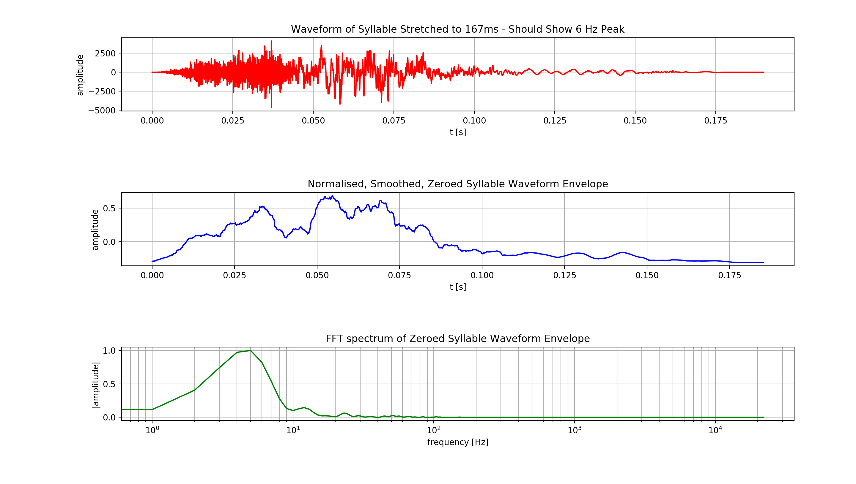
Waveform stretched
167ms length
stretched signal
signal Envelope
Shows 5/6 Hz peak
modulation spectrum

Slide 41
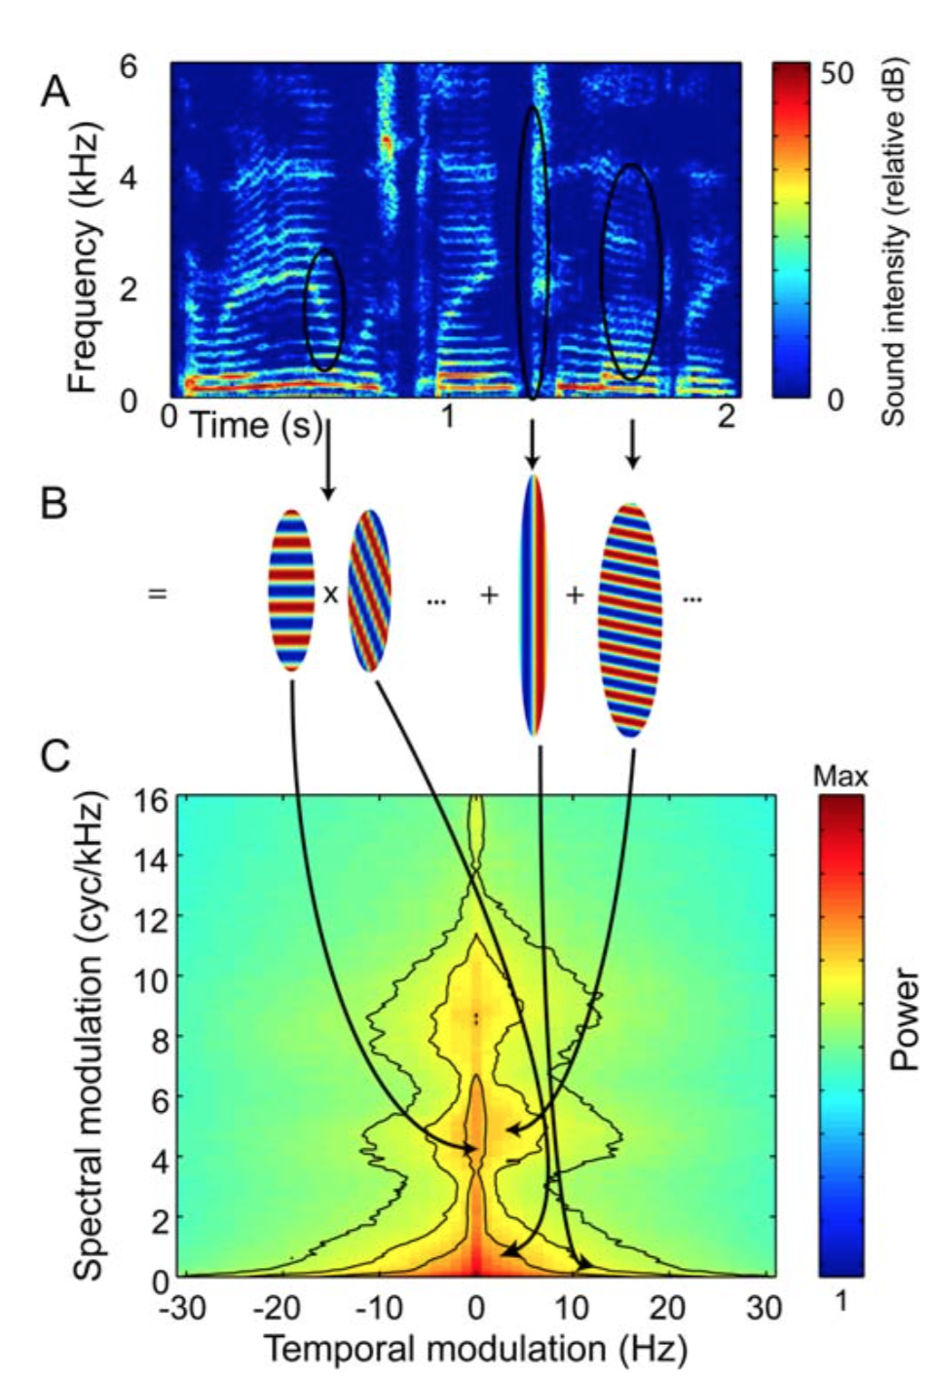
Analysis and manipulation of modulation envelopes
Elliott TM, Theunissen FE (2009) The Modulation Transfer Function for Speech Intelligibility. PLoS Comput Biol 5(3): e1000302. doi:10.1371/ journal.pcbi.1000302

Slide 42
Original speech sound

Slide 43
TEMPORAL MODULATION ABOVE 3Hz FILTERED OUT

Slide 44
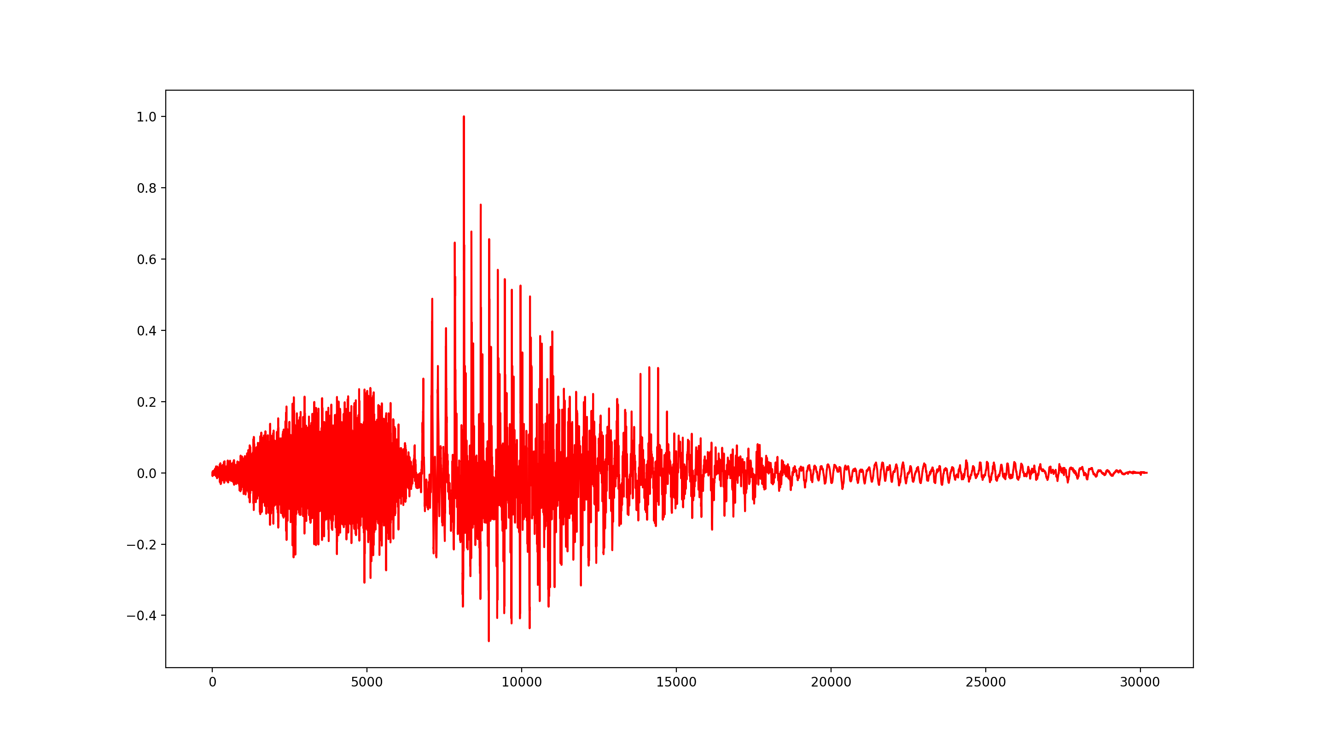
My signal chain: Start with word (Sam)

Slide 45
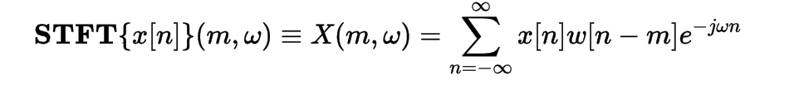
Overlap-window signal and take fft of each overlapping window: stft

Slide 46
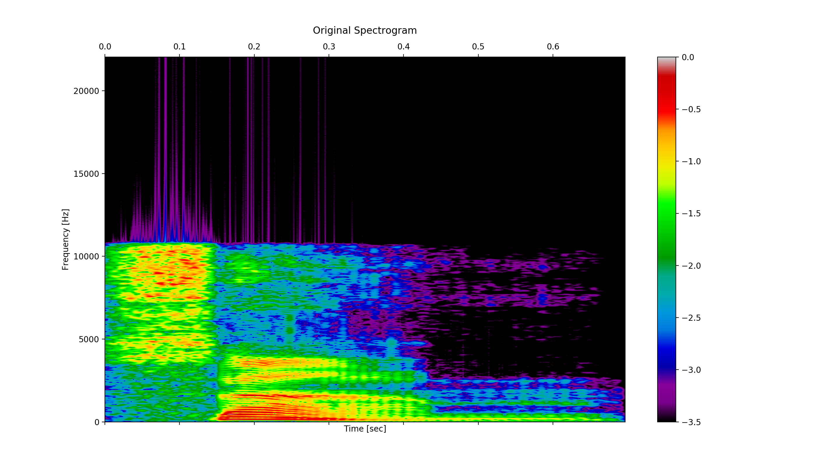
Take absolute value, interpolate with Gaussian and display matrix: spectrogram

Slide 47
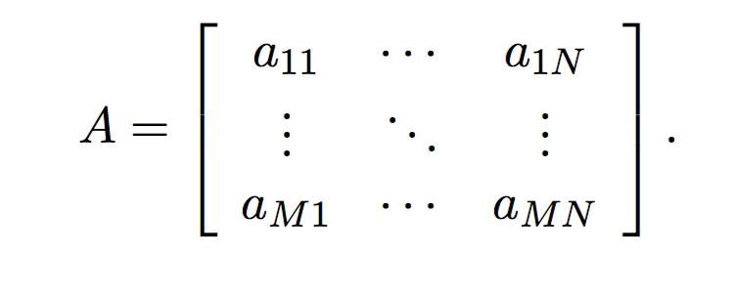
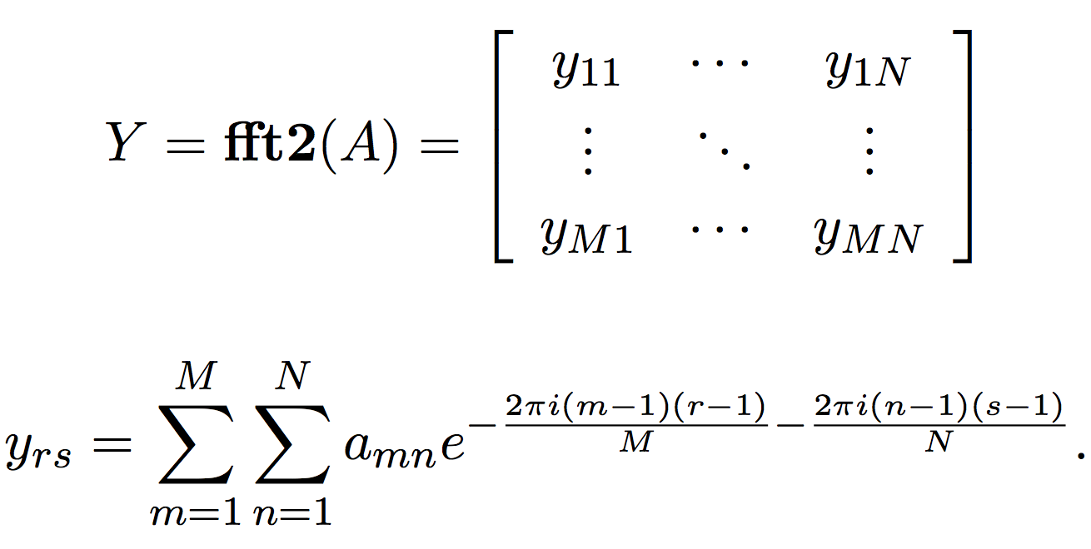
2D DFT
spectrogram matrix
complex matrix

Slide 48
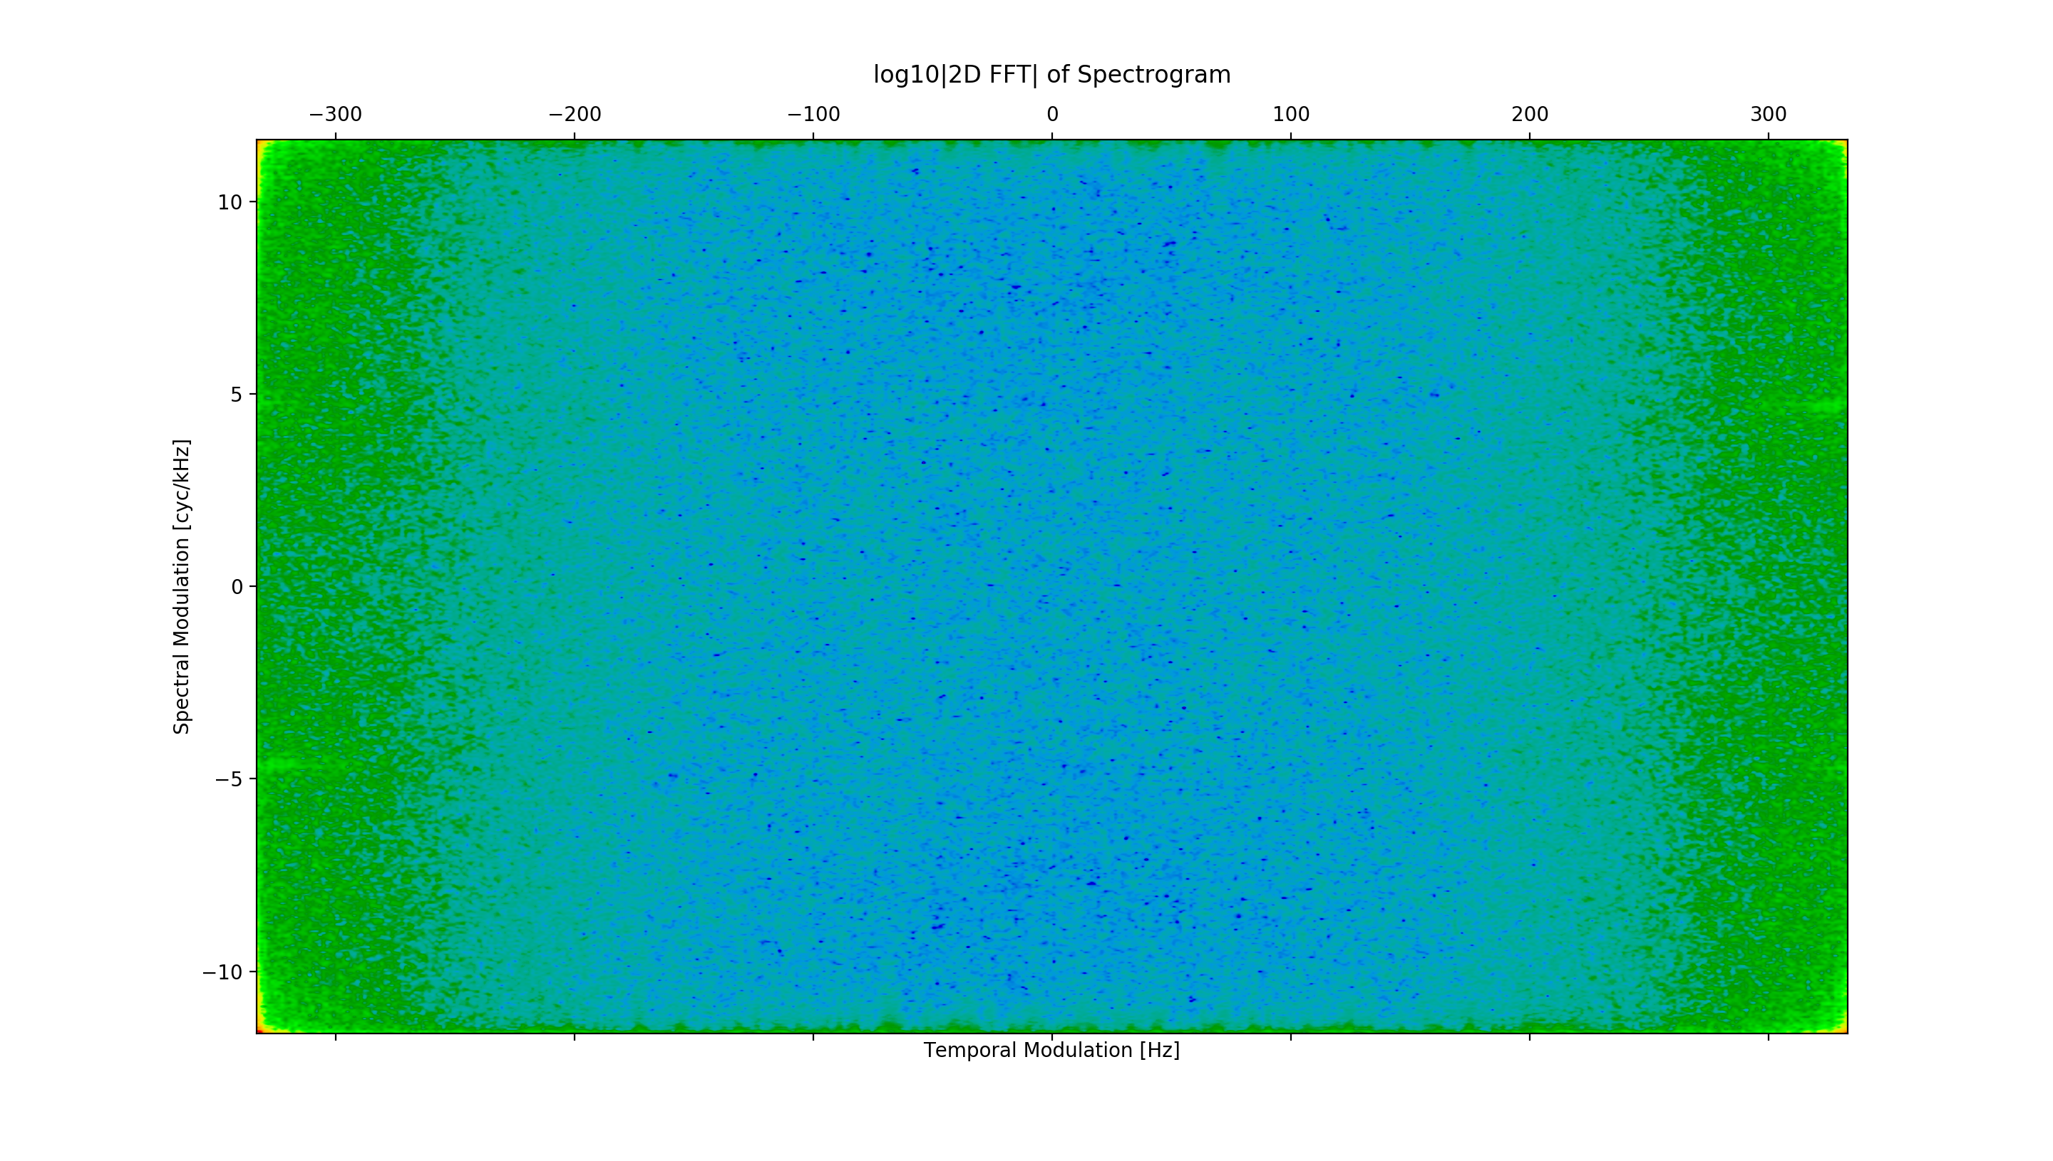
Take 2d fft of spectrogram and Plot logarithm of magnitude of 2d fft
Conjugate symmetry
In quadrants of
Resulting matrix

Slide 49
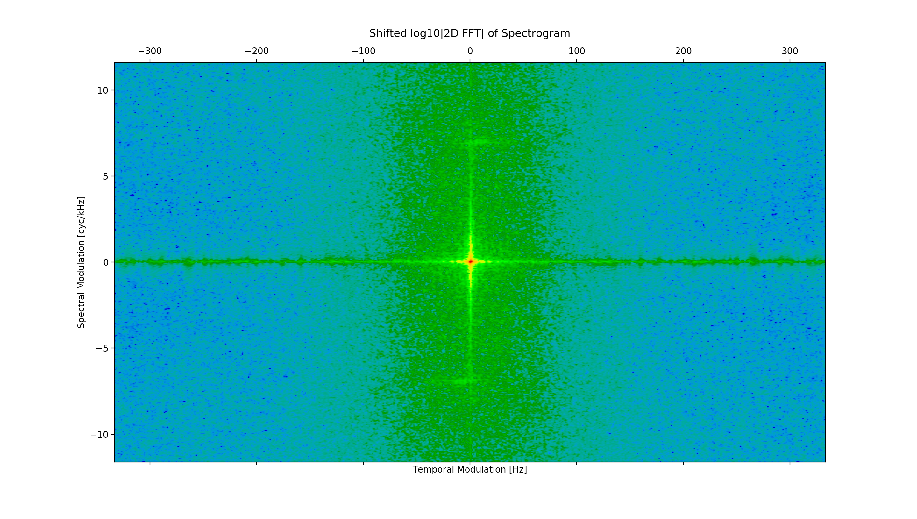
Shift quadrants so low frequencies are centered
Temporal modulation
amplitude and frequency
Along horizontal axis
Frequency modulation
amplitude and frequency
along vertical axis

Slide 50
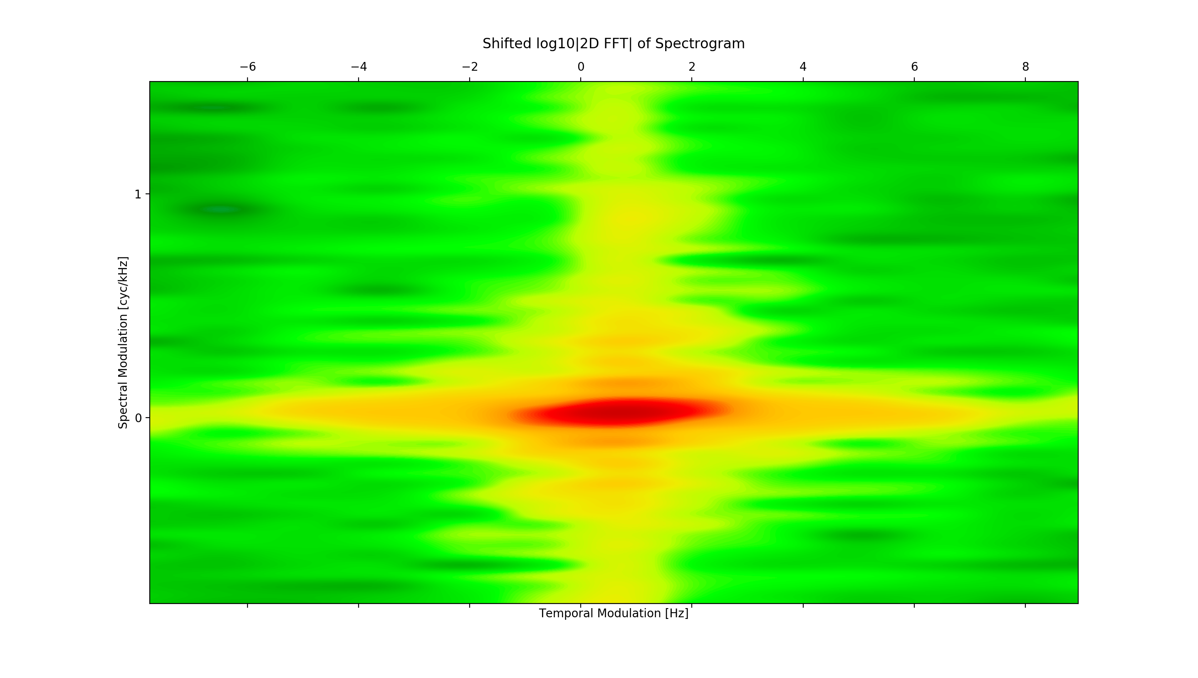
Zoomed in

Slide 51
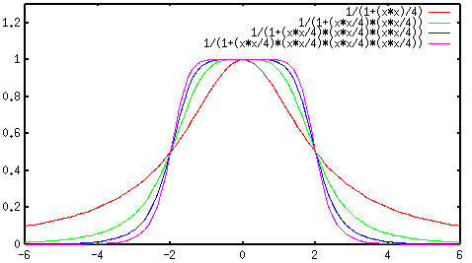


2d butterworth filter mask

Slide 52

2d Butterworth filtering

Slide 53

2d Butterworth filtering

Slide 54

2d Vertical Butterworth filtering

Slide 55

2d Vertical Butterworth filtering

Slide 56

SHIFT BACK FFT, TAKE IFFT AND THEN TAKE MAGNITUDE OF RESULT TO RECONSTRUCT SPECTROGRAM

Slide 57
Recover time domain signal from spectrogram
Based on MATLAB implementation from Spectrogram Inversion Toolbox
“An even better solution is to do the inversion, explicitly looking for a good set of phases. This toolbox does that, after the inverse Fourier transform of each slice, by finding the best time delay so the new frame and the summed frames to now are consistent. This is equivalent to starting with some arbitrary linear phase. The effect of this is to reduce the reconstruction error by an order of magnitude. Hurray.”
recovered
original

Slide 58

Spatially filtered spectrogram results: filtering
un-filtered
filtered

Slide 59

Spatially filtered spectrogram results: filtering
un-filtered
filtered

Slide 60
Spatially filtered spectrogram results: filtering
un-filtered
filtered

Slide 61

Spatially filtered spectrogram results: heavy filtering
un-filtered
filtered

Slide 62

Spatially filtered spectrogram results: heavy filtering
un-filtered
filtered

Slide 63
Spatially filtered spectrogram results: filtering
un-filtered
filtered

Slide 64


Spatially filtered spectrogram results: filtering A sentence
un-filtered
filtered

Slide 65


Spatially filtered spectrogram results: filtering A sentence
un-filtered
filtered

Slide 66
Spatially filtered spectrogram results: filtering A sentence
un-filtered
filtered

Slide 67

Spatially filtered spectrogram results: filtering A sentence heavily
un-filtered
filtered

Slide 68

Spatially filtered spectrogram results: filtering A sentence
un-filtered
filtered

Slide 69
Spatially filtered spectrogram results: filtering A sentence
un-filtered
filtered

Slide 70

Spatially filtered spectrogram results: filtering A sentence heavily
un-filtered
filtered

Slide 71

Spatially filtered spectrogram results: filtering A sentence
un-filtered
filtered

Slide 72
Spatially filtered spectrogram results: filtering A sentence
un-filtered
filtered

